Slide 1
Lecture-2
Color Models

Slide 2
What is Color
- Color is a powerful descriptor that often simplifies object identification and extraction from a scene.
- Color is a fundamental attribute of our viewing experience

Slide 3

Preview

Slide 4
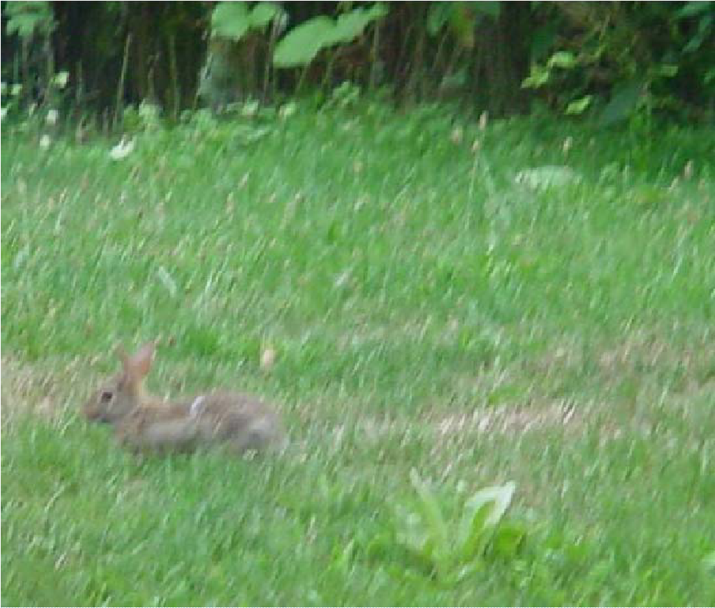
Preview

Slide 5
Light
Light is fundamental for color vision
Unless there is a source of light, there is nothing to see!
What do we see?
We do not see objects, but the light that has been
reflected by or transmitted through the objects

Slide 6
Light and EM waves
Light is an electromagnetic(EM) wave
If its wavelength is comprised between 400 and 700 nm (visible spectrum), the wave can be detected by the human eye and is called monochromatic light

Slide 7
Physical properties of light
This distribution may indicate:
a dominant wavelength (or frequency) which is the color of the light (hue),
brightness (luminance), intensity of the light (value),
purity (saturation), which describes the degree of vividness.

Slide 8
Types of Color Model
RGB model
  Color monitor, color video cameras
CMY model
  Color printer
HSI model
  Color image manipulation
XYZ (CIE standard, Y directly measures the luminance)
YUV (used in PAL color TV)
YIQ (used in NTSC color TV)
YCbCr (used in digital color TV standard BT.601)

Slide 9
Color Fundamentals (con’t)c
Basic quantities to describe the quality of light source:
  Radiance: Total amount of energy that flows from the light source (in W).
  Luminance: A measure of the amount of energy an observer perceives from the light source (in lm)
  Brightness: A subjective descriptor that embodies the achromatic notion of intensity and is practically impossible to measure.

Slide 10
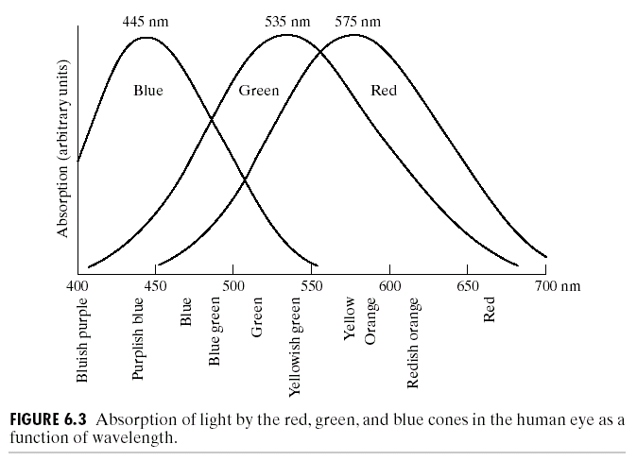
Color Fundamentals (con’t)
Standard wavelength values for the primary colors

Slide 11
Color Fundamentals (con’t)
The characteristics generally used to distinguish one color from another are Brightness, Hue, and Saturation.
  Hue: Represents dominant color as perceived by an observer.
  Saturation: Relative purity or the amount of white light mixed with a hue
Hue and saturation taken together are called Chromaticity, and therefore, a color may be characterized by its Brightness and Chromaticity.

Slide 12
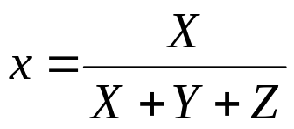
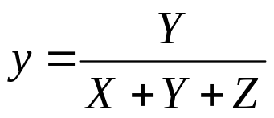


Color Fundamentals (con’t)
Tri-stimulus values: The amount of Red, Green and Blue needed to form any particular color
Denoted by: X, Y and Z
Tri-chromatic coefficient:

Slide 13
Color Models
The purpose of a color model (also called color space or color system) is to facilitate the specification of colors in some standard, generally accepted way.
RGB (red, green, blue) : monitor, video camera.
CMY(cyan, magenta, yellow),CMYK (CMY, black) model for color printing.
and HSI model, which corresponds closely with the way humans describe and interpret color.

Slide 14
RGB (red, green, blue)
The RGB colour space is related to human vision through the tristimulus theory of colour vision.
The RGB is an additive colour model. The primary colours red, green and blue are combined to reproduce other colours.
In the RGB colour space, a colour is represented by a triplet (r,g,b)
r gives the intensity of the red component
g gives the intensity of the green component
b gives the intensity of the blue component
Here we assume that r,g,b are real numbers in the interval [0,1].
You will often see the values of r,g,b as integers in the interval [0,255].

Slide 15
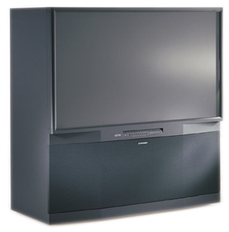
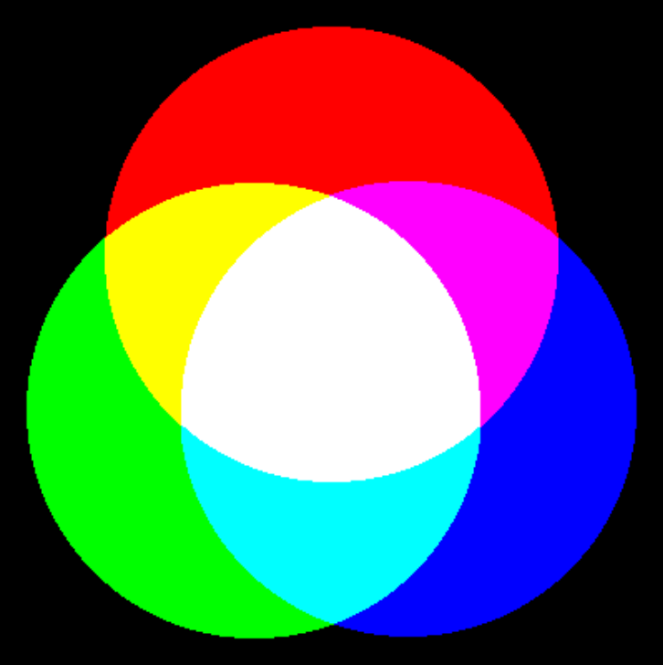
RGB Color model
Source: www.mitsubishi.com
Active displays, such as computer monitors and television sets, emit combinations of red, green and blue light. This is an additive color model

Slide 16
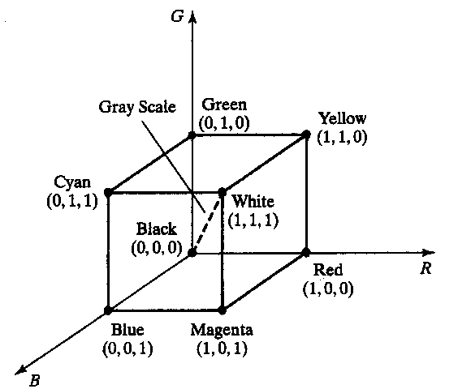
The RGB Color Spaces

Slide 17
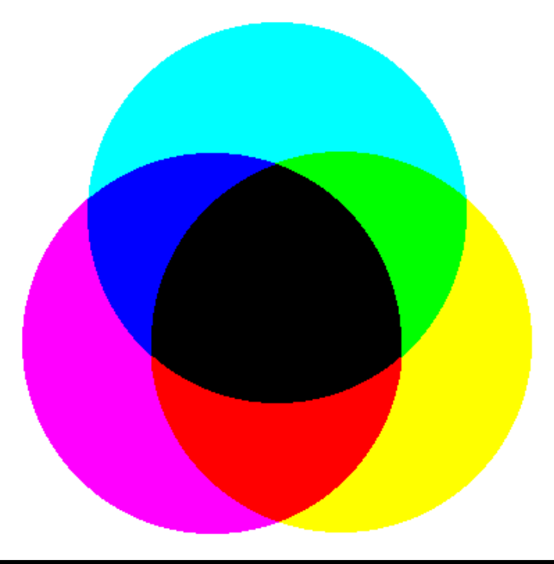

CMY Color model
Source: www.hp.com
Passive displays, such as color inkjet printers, absorb light instead of emitting it. Combinations of cyan, magenta and yellow inks are used. This is a subtractive color model.

Slide 18
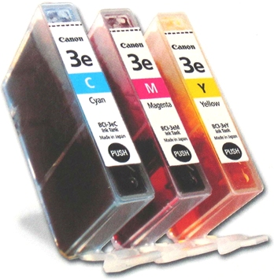
CMY
CMY cartridges for colour printers.

Slide 19
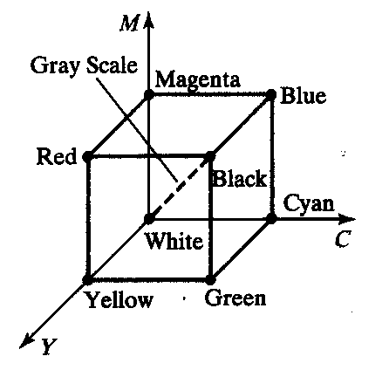
The CMY and CMYK Color Spaces

Slide 20
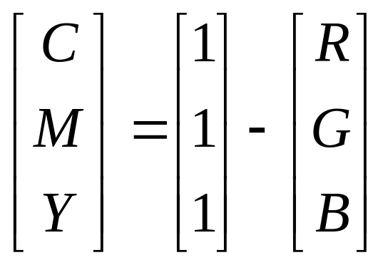
The CMY and CMYK Color Models
Cyan, Magenta and Yellow are the secondary colors of light
Most devices that deposit colored pigments on paper, such as color printers and copiers, require CMY data input.

Slide 21
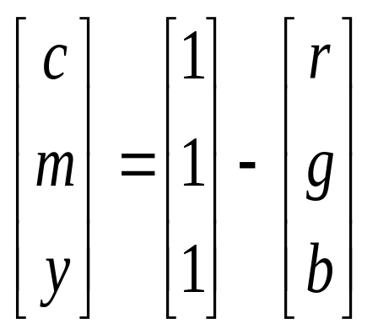
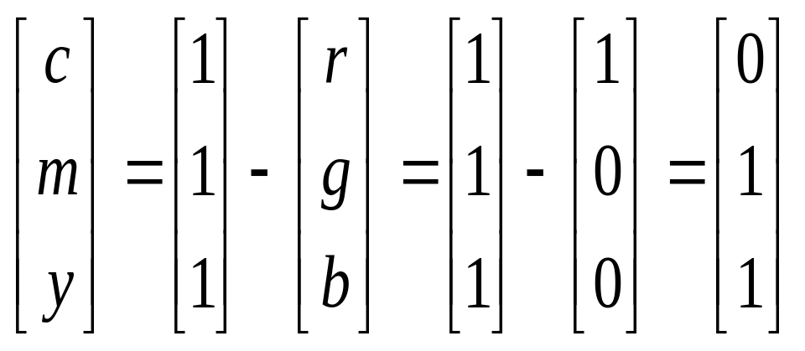
The conversion from RGB to CMY is given by the formula
Example 11.2: The red colour is written in RGB as (1,0,0). In CMY it is written as
that is, magenta and yellow.

Slide 22
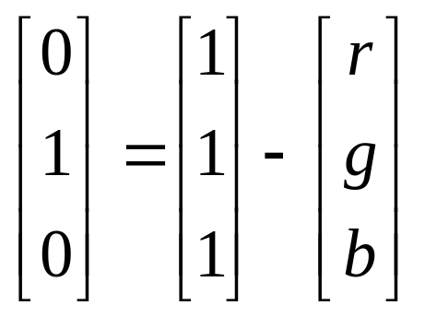
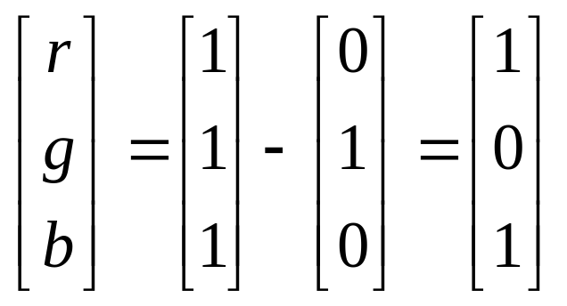
Example 11.3: The magenta is written in CMY as (0,1,0). In RGB it is
written as
giving,
that is, red and blue.

Slide 23
CMYK model
For printing and graphics art industry, CMY is not enough; a fourth primary, K which stands for black, is added.
Conversions between RGB and CMYK are possible, although they require some extra processing.

Slide 24



HSI Color Model
H
dominant
wavelength
S
purity
% white
I
Intensity
Source: http://www.cs.cornell.edu/courses/cs631/1999sp/

Slide 25
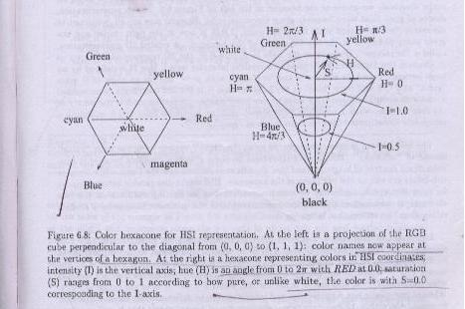

Slide 26
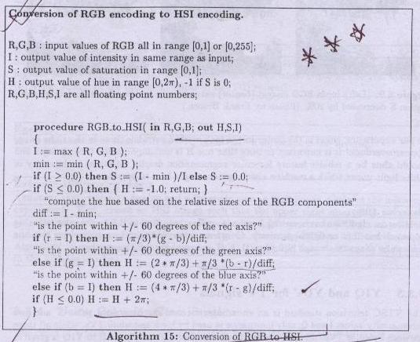

Slide 27
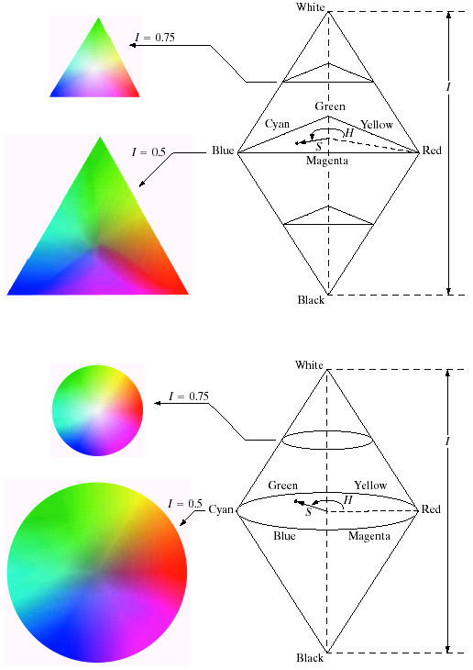
HSI Color Model

Slide 28
HSI Color Model
Hue is defined as an angle
  0 degrees is RED
  120 degrees is GREEN
  240 degrees is BLUE
Saturation is defined as the percentage of distance from the center of the HSI triangle to the pyramid surface.
  Values range from 0 to 1.
Intensity is denoted as the distance “up” the axis from black.
  Values range from 0 to 1

Slide 29
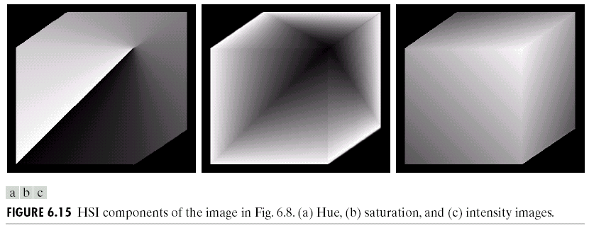
The HSI Color Models

Slide 30
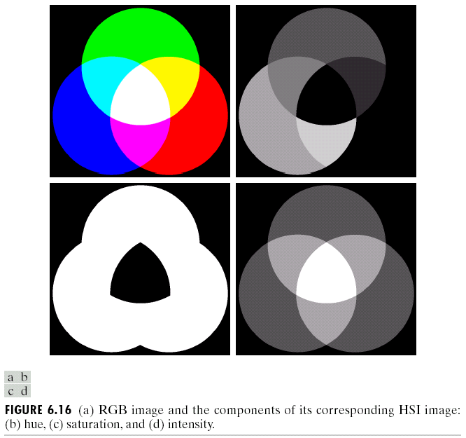
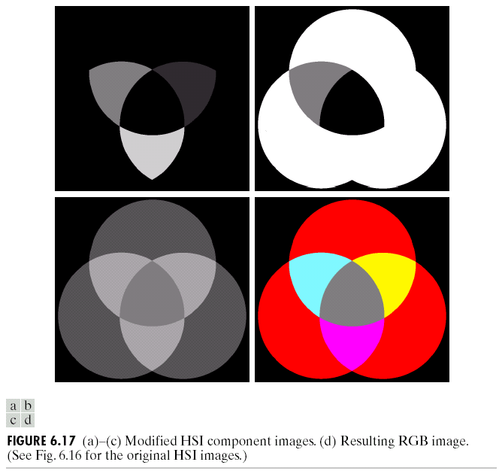
The HSI Color Models
RGB
H
H
S
S
I
I
RGB

Slide 31
HSV
The components of the HSV colour space are Hue, Saturation and Value.
Colour is the result of the perception of light at different wavelengths. Usually, we do not experience light at a single wavelength but a blend of waves at different wavelengths. The hue corresponds to the dominant wavelength and determines the type of the colour, for example red, yellow, or blue.
The saturation determines the purity of the colour. High saturation gives pure colours (narrow wavelength band), while low saturation means colours mixed with a lot of white (white light combines all the visible wavelengths).
The value determines the brightness. A value equal to zero represents absence of light, while a high value gives bright colours.

Slide 32
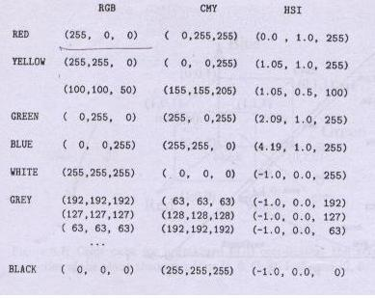

Slide 33
Thank You

